Slide 1
Health insurance cost prediction using machine learning
UNDER THE GUIDANCE OF
MR. K. MOORTHY, MCA.,
DEPARTMENT OF COMPUTER APPLICATIONS
TAMIL SELVAN P
II-MCA
22CSEA74

Slide 2
INTRODUCTION
The insurance industry plays a pivotal role in managing financial risks and providing security to individuals and businesses. One of the critical aspects of this industry is accurately estimating insurance costs, which can be influenced by a multitude of factors ranging from demographics to policy coverage. To enhance the efficiency and accuracy of cost estimation, predictive modeling techniques are being increasingly employed. This project aims to develop a sophisticated predictive model for insurance cost estimation, leveraging the power of data science and machine learning.

Slide 3
Here I used four algorithm to predict the accuracy of the prediction and to find the best one which give the accuracy right. Thr four algorithm are Linear Regression , Support Vector Regressor, Random Forest Regressor, Gradient Boosting Regressor

Slide 4
Software requirement
Programming Language
Python: Widely used for data analysis, Python has a rich ecosystem of libraries and tools that are well-suited for tasks such as data cleaning, exploration, and visualization.
Libraries
➢ visual studio code are used as IDE.
➢ Pandas: A powerful data manipulation library for cleaning and processing structured data.
Matplotlib and Seaborn: Libraries for creating static, interactive, and aesthetically pleasing visualizations.

Slide 5
Statistical Analysis
NumPy: Fundamental package for scientific computing with support for large, multi- dimensional arrays and matrices.
SciPy: A library for scientific and technical computing that builds on NumPy and provides additional functionality.

Slide 6
DATA EXPLORATION
Data Collection
The dataset is taken from the Kaggle site, US dataset are used in this project
The dataset has seven attribute (Age, BMI(Body Mass Index), Children, Gender, Smoker, Region, Charges)
In this dataset Age, BMI, Children,Gender,Smoker,Region = Independent variable
Charges are the Dependent variable.
Data Preprocessing
Before training the four selected model, we preprocessed the data to ensure that it was in a suitable format for analysis. We performed the following steps:

Slide 7
1. Data Cleaning: We removed records with missing or invalid data.
2. Data Transformation: We transformed categorical variables into numerical values.
Here categorical variable is
sex= Male /0
Female /1
Smoker = yes / 0
no / 1
Region = Southeast / 0
Southwest /1
Northeast /2
Northwest /3

Slide 8
3. Feature Selection: We used feature selection techniques such as correlation analysis to identify the most relevant features for charges and smokers.
Model Training and Evaluation
We used the scikit-learn, a popular machine learning library in Python, to train a linear regression model on the preprocessed data. We split the data into training and testing sets, with 70% of the data used for training and 30% for testing. We used root mean absolute error (MAE) error as the evaluation metric to measure the accuracy of the model.
Prediction
Once the model was trained and evaluated, we compare the four models and identify the model which gives the best accuracy of results.

Slide 9
EXPLORATORY DATA ANALYSIS
Exploratory Data Analysis (EDA) is the process of examining and analyzing datasets to review their main characteristics, usually with visual methods. It is used to discover patterns, relationships, anomalies and other insights that might be hidden in the data. EDA is an important step in the data analysis process because it helps to better understanding of the data, identify potential problems or errors and generate hypotheses.

Slide 10
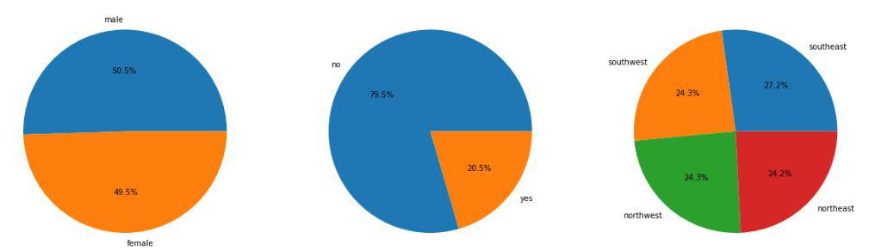
MACHINE LEARNING MODELS
Visualization
pie chart
pie chart Represent sex,smoker,and region

Slide 11
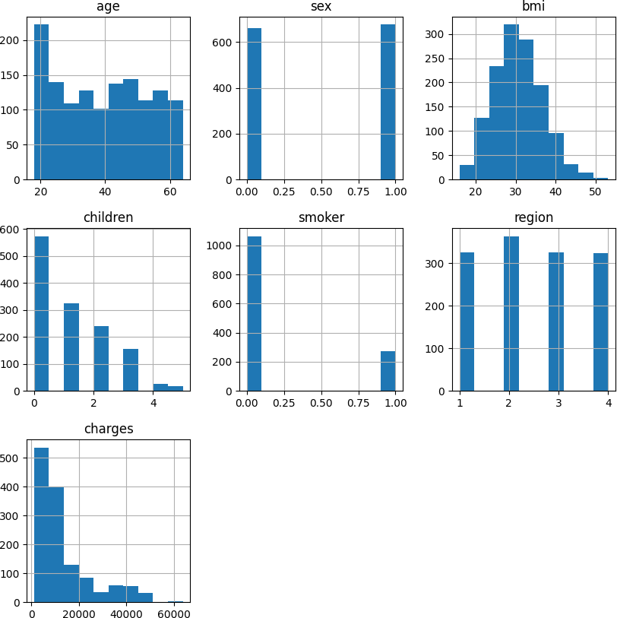
Histogram

Slide 12
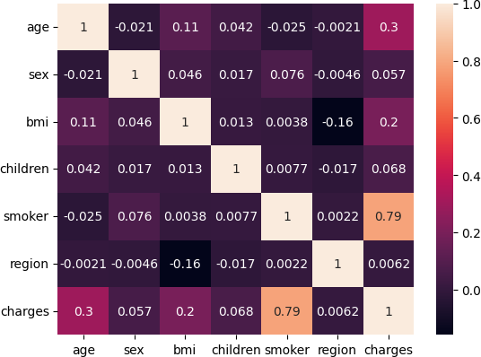
Heat Map
Heatmaps are a compelling way to visualize relationships between variables in high dimensional space.
CORRELATION OF ALL THE DATA SET

Slide 13
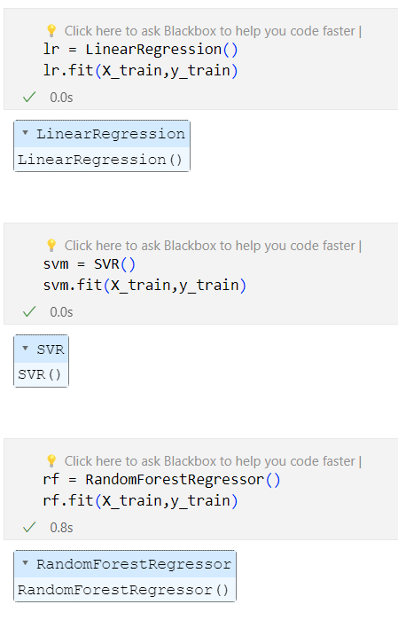
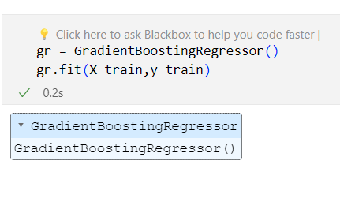
MACHINE LEARNING MODEL
TRAIN AND TEST
from sklearn.model_selection import train_test_split
X_train,X_test,y_train,y_test=train_test_split(X,y,test_size=0.2,random_state=42)
TRAIN THE MODELS
Here we Trained the model for Random Forest Regressor using X_train and y_train.
This is the same step for all the regression algorithm we used.

Slide 14
PREDICTION ON TEST DATA
Here we predicted on the test data (X_test) and compare the actual value and predicted value
y_pred1 = lr.predict(X_test)
y_pred2 = svm.predict(X_test)
y_pred3 = rf.predict(X_test)
y_pred4 = gr.predict(X_test)
df1 = pd.DataFrame({'Actual':y_test,'Lr':y_pred1, 'svm':y_pred2,'rf':y_pred3,'gr':y_pred4})
df1

Slide 15
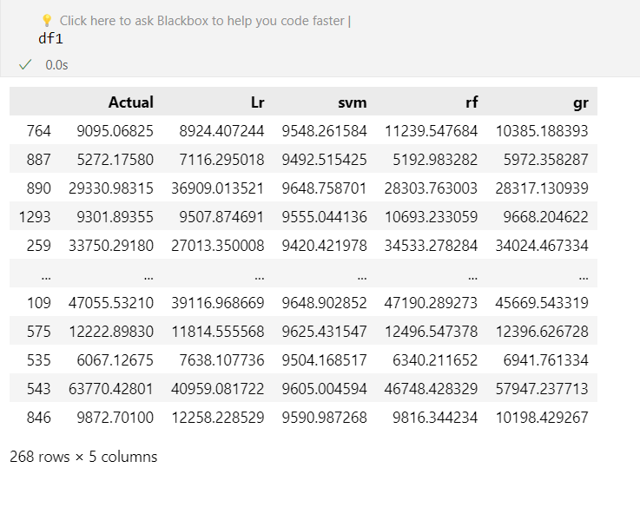
ACTUAL & PREDICTED CHARGES

Slide 16
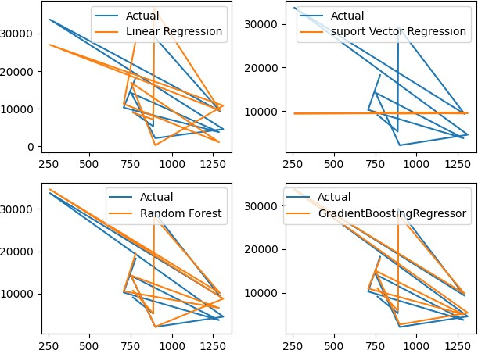
Comparison chart

Slide 17
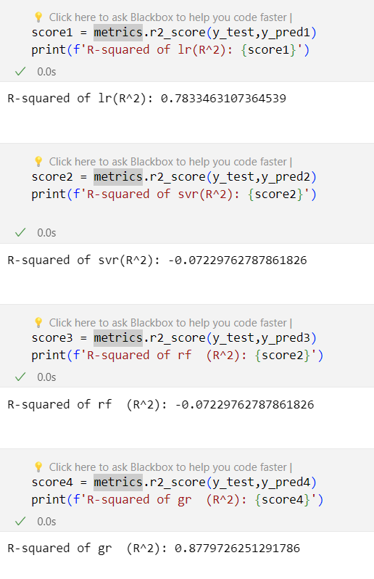
Evaluate the algorithm
Y_test is represents the actual (true) values of the dependent variable for a test set.
Y_predict1 is represents the predicted values for the dependent variable. These values are obtained from a regression model.
The R-squared score ranges from 0 to 1, where 1 indicates a perfect fit, meaning the model's predictions perfectly match the actual values.
R-Squared Value

Slide 18
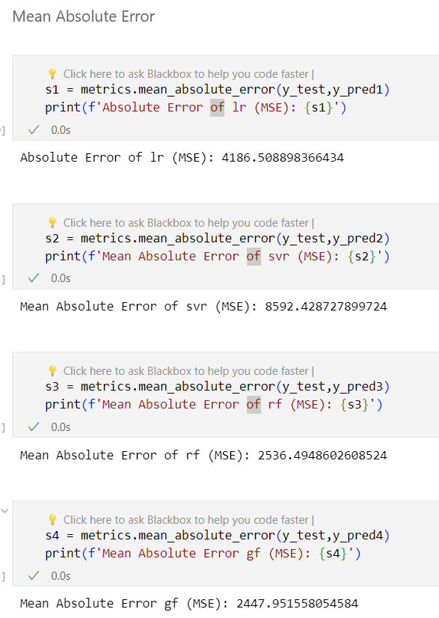
Mean absolute error
Mean Absolute Error (MAE) is a metric that measures the average absolute differences between the actual values and the predicted values.

Slide 19
Predict charges for new customer
data = {'age' : 40,
'sex' : 1,
'bmi' : 40.30,
'children' : 4,
'smoker' : 1,
'region' : 2}
df = pd.DataFrame(data,index=[0])
df

Slide 20
Predict the new charges
new_pred = gr.predict(df)
print("Medical Insurance cost for New Customer is : ",new_pred[0])
Medical Insurance cost for New Customer is : 42148.36188800323
Gradient Boosting Regressor is the best regressor model compare to other model
Save the model:
Save model using joblib library and the named as model_joblib_gr

Slide 21
CONCLUSION
The Gradient Boosting offers the best efficiency, with an accuracy of 87.86. Gradient boosting can therefore be used in the estimation of insurance costs with better performance than other regression models. Forecasting insurance prices supported sure factors facilitate insurance suppliers to draw in customers and save time in formulating plans for each individual. Machine learning can considerably minimize these individual efforts in policymaking, as metric capacity unit models can do cost calculation in a very short time, whereas somebody's being would be taking a protracted time to perform constant tasks. This may help businesses improve their profitability.

Slide 22
THANK YOU

